Slide 1


Effective and Coordinated ROAD infrastructure Safety operations
Carlo Polidori
AIPSS - Associazione Italiana dei Professionisti per la Sicurezza Stradale – Presidente
(adattamento della presentazione al 1st IRF Europe & Central Asia Regional Congress – Istanbul del 15.09.2015

Slide 2
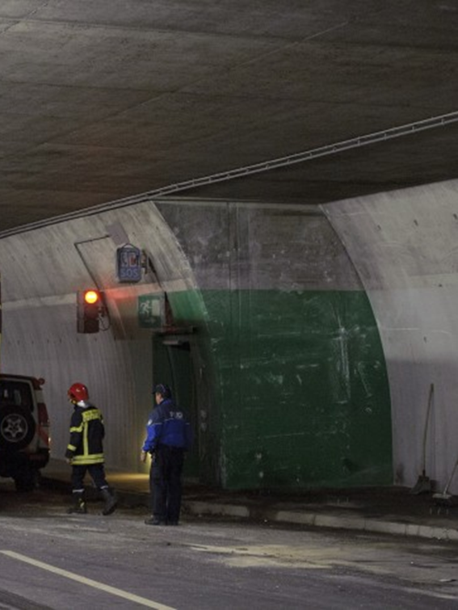
1. Come nasce il progetto ECOROADS
Coach crash in Sierre Tunnel (Switzerland)
The collision occurred on March 2012 with the end wall of a lay-by in the Sierre tunnel, Switzerland, which opened in 1999 and was rated as “good” in a 2005 European Tunnel Assessment Programme (EuroTAP) test.
28 fatalities, including 22 childrens

Slide 3
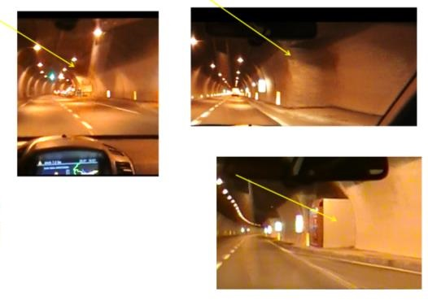
1. Come nasce il progetto ECOROADS
The yellow arrows show a typical situation in several European tunnels.

Slide 4
1. BACKGROUND AND INTRODUCTION
1. Come nasce il progetto ECOROADS
A debate that was initiated between international experts , underlining how safety prevention measures, according to the prescriptions of the Directive 2008/96/EC, could have been beneficial for risk prevention.
However, this Directive does not apply to road tunnels covered by Directive 2004/54/EC
The debate clearly highlighted a gap between the two Directives.

Slide 5
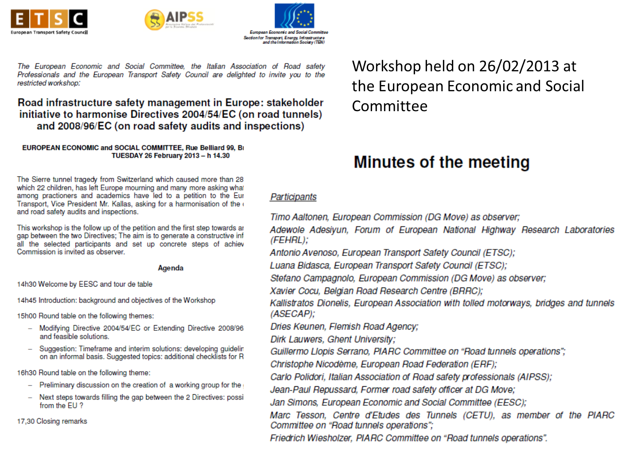
2. Eventi Preliminari
The European Economic and Social Committee hosted two dedicated workshops on February and March 2013

Slide 6
2. OBIETTIVI
Following the two workshops, the ECOROADS project was conceived to overcome the barrier established by the formal interpretation of the two Directives 2008/96/EC and 2004/54/EC.

Slide 7
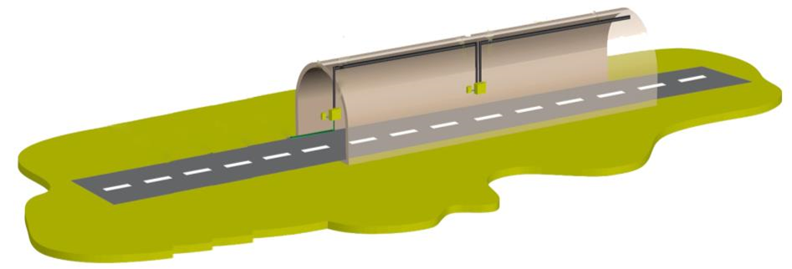
3. SOLUZIONI PROPOSTE
Mixed groups of tunnel and road safety experts coming from different EU countries
Joint “visits” in both tunnels and adjacent open roads in several locations in Europe.
Tunnel experts
Road safety experts
The exchange of opinions and different point will led to a common practical procedure (Guidelines and recommendations) that will fill the gap and enhance safety

Slide 8
3. SOLUZIONI PROPOSTE
The experts are provided by six thematic Associations covering the whole Europe:
FEHRL-Forum Des Laboratoires Nationaux Europeens De Recherche Routiere;
ETSC-European Transport Safety Council ;
ERF-The European Union Road Federation;
ASECAP - European Association with tolled motorways, bridges and tunnels;
AIPSS-Italian Association of Road Safety Professionals;
SEETO - South East Europe Transport Observatory
External experts are admitted, too

Slide 9
4. IMPLEMENTAZIONE DEL PROGETTO
Overview of the application of the two Directives 2008/96/EC and 2004/54/EC
Workshops with stakeholders
Seminars and meetings between European experts of open roads and tunnels safety
Workshop 1
Decision about the field tests and the common procedures to be applied
Joint Road safety visits
(5 or more field tests in Europe)
Feedback from the first 2 site visits
Workshop 2
Fine tuning of the common procedures
Workshop 3
Feedback from the other site visits
GUIDELINES AND RECOMMENDATIONS

Slide 10
4. IMPLEMENTAZIONE DEL PROGETTO
The candidatures of the test sites are under examination by a project Committee
14 candidatures from 10 Countries
Albania
Belgium (Flanders)
Czech Republic
Germany
Italy
Republic of Macedonia
Montenegro
Norway
Serbia
Slovakia
The first five sites will be selected at the end of September 2015
The project will try (within the limit of the assigned budget) to extend the number of the test sites
Candidatures remain open up to mid 2016, try to apply!
Mail in the last slide

Slide 11
5. PROSSIME PRIME AZIONI DEL PROGETTO
First workshop with the Stakeholders – Brussels 30 September 2015
Free participation by registering at:
www.eventbrite.fr/e/workshop-on-roads-tunnels-safety-management-tickets-17880674579.

Slide 12
5. PROSSIME PRIME AZIONI DEL PROGETTO
More details at: http://fehrl.org/index.php?m=33&a=content&id=975

Slide 13
6. IMPORTANZA DI QUESTO SEMINARIO
I risultati dell’evento odierno verranno riportati ai tavoli di discussione del workshop e quindi la posizione del partner Italiano all’interno del progetto europeo rifletterà le effettive necessità e problematiche espressi dagli stakeholders del nostro Paese

Slide 14



Grazie per l’attenzione!
www.ecoroadsproject.eu
Carlo Polidori
Associazione Italiana Professionisti Sicurezza Stradale www.aipss.it
c.polidori@libero.it
Adewole ADESIYUN (Project Coordinator)
Forum of European National Highway Research Laboratories –www.fehrl.org
adewole.adesiyun@fehrl.org

